Slide 1
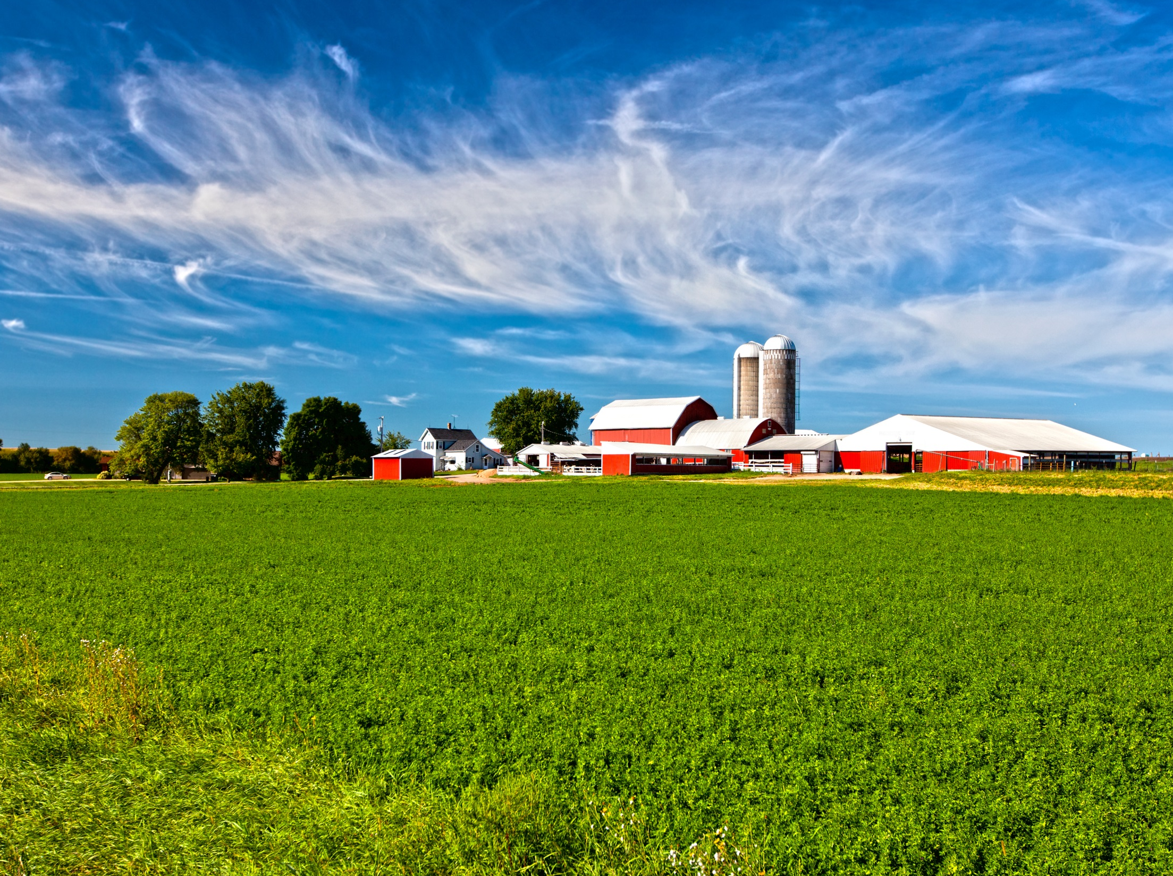

C-PACE Overview
Commercial Property Assessed Clean Energy (C-PACE)
www.pacewi.org
Kim Johnston
Market Development Director - PACE
608.729.6900
kjohnston@slipstreaminc.org

Slide 2
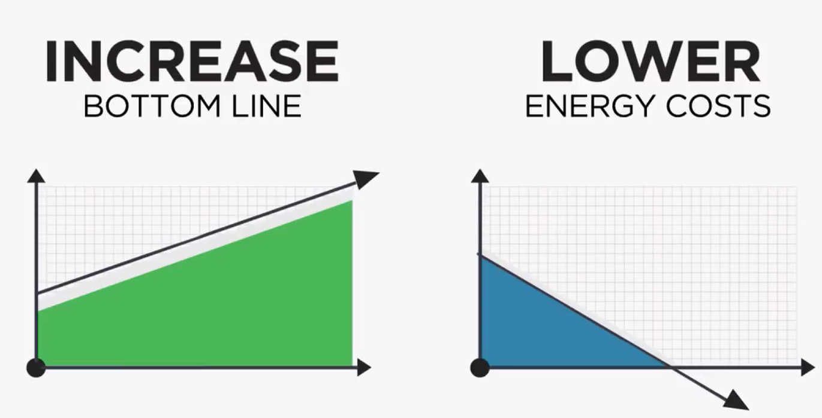
What is C-PACE?
C-PACE is a property tax-assessment financing mechanism for energy & water efficiency and renewable energy improvements to commercial properties.
Benefits:
Finance up to 100% of hard + soft costs
  Non-recourse financing
  Frees up equity for other priorities
Fixed rate, long-term: 20 – 30 years
  Yields positive cash flow
  Boost Property Value
Tenants share cost & savings
Transfers to new owner upon sale
Potential off-balance sheet treatment
Reduce waste & improve experience

Slide 3
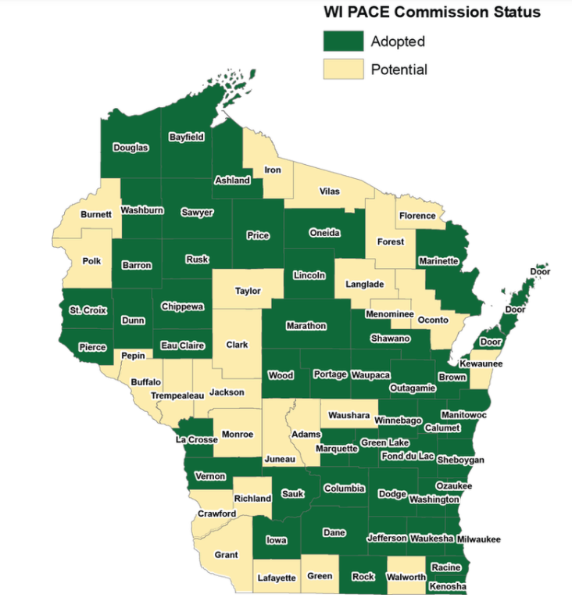
Available Statewide

Slide 4
C-PACE in the Capital Stack
Example: $20 Million Renovation or New Construction Project
Cost of Capital:
8.40%
7.20%
Owners utilize PACE to fill gaps in their capital stack and lower their cost of capital.

Slide 5









Eligible C-PACE Projects
Commercial Properties
Project Types
Renovations
New Construction
Adaptive Reuse
Refinance
Equipment Installation
OFFICE
INDUSTRIAL
MULTIFAMILY
* Property located in member county
* Does NOT work for residential (1-4 units) and government owned properties
RETAIL
HEALTHCARE
HOSPITALITY
NONPROFIT
AGRICULTURAL
MIXED USE

Slide 6
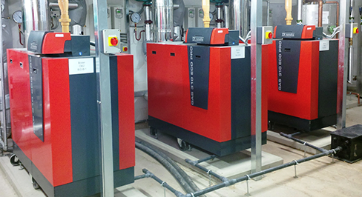
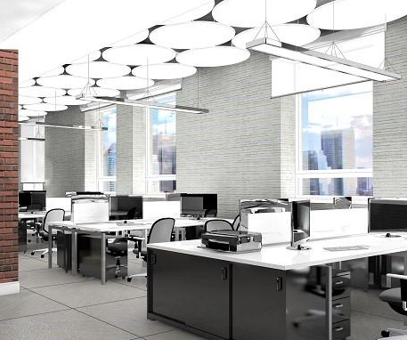
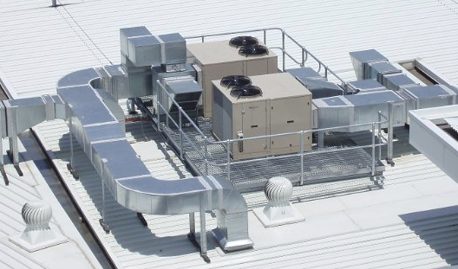

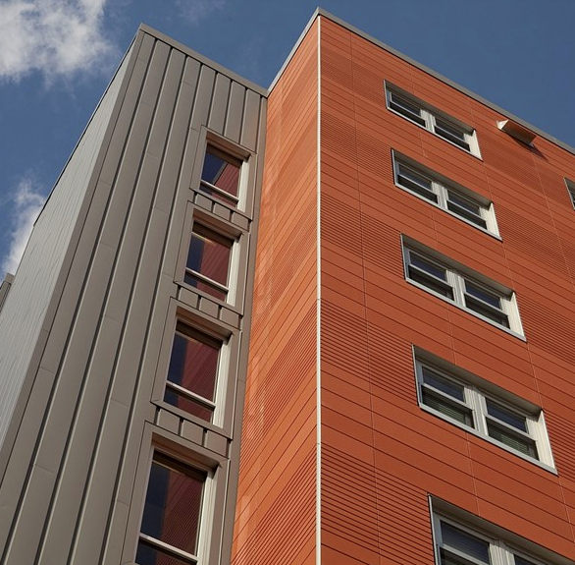
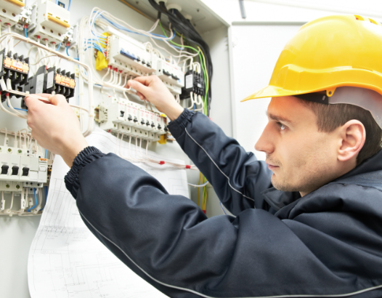
Eligible Improvements
Energy & Water Efficiency
Lighting Systems
Building Controls
Building Envelope Improvements
Furnaces, Boilers & Chillers
Heat Pumps
Pumps, Motors & Variable Speed Drives
Low flow fixtures
Heat Recovery
Fuel Switching

Slide 7



Eligible Improvements
Eligible Improvements
Renewable Energy
Solar PV
Battery Storage
Biofuel
Wind

Slide 8
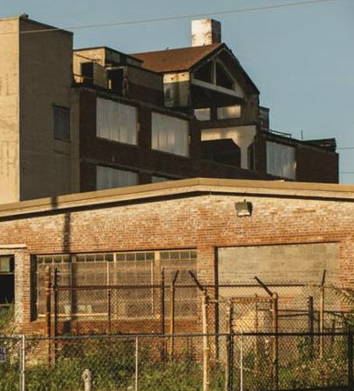
Brownfields – Eligible Improvement
66.0627(8)(a) Enables PACE Financing for Brownfield Revitalization Project (BRP).
Brownfield Revitalization Project - Any of the following actions when taken upon commercial or industrial premises that are located on, or that constitute, brownfields, as defined in s. 238.13 (1) (a):
  1. Site assessment.
  2. Remediation.
  3. Lead or asbestos abatement.
  4. Demolition.
  5. Standard site preparation actions not included in subds. 1. to 4.
Term of BRP PACE Financing may exceed 20 years.

Slide 9
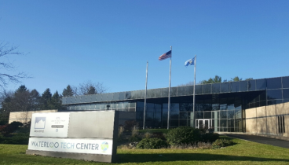
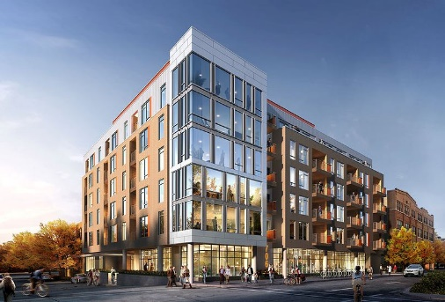
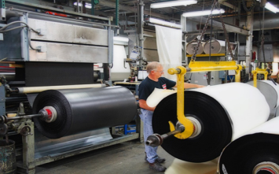
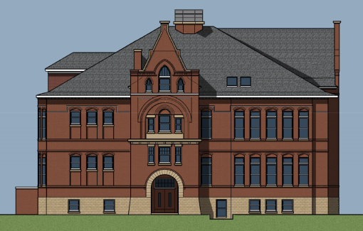
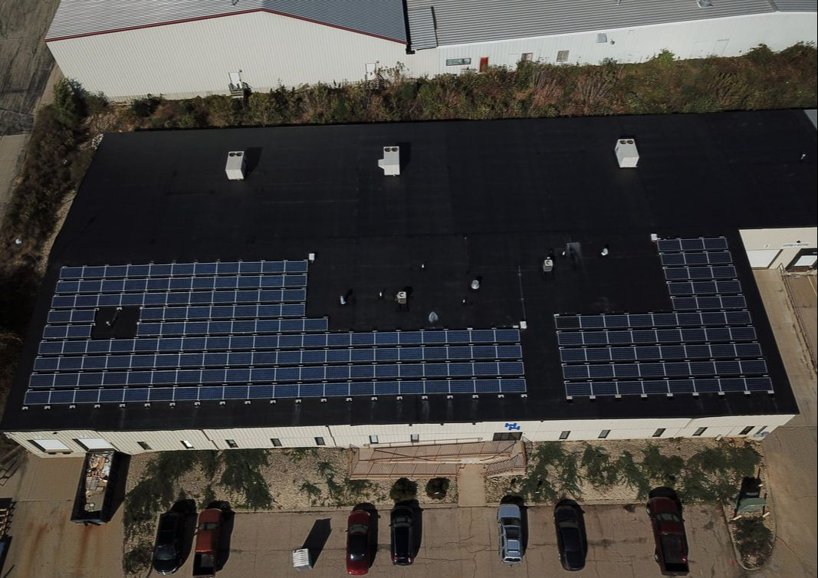
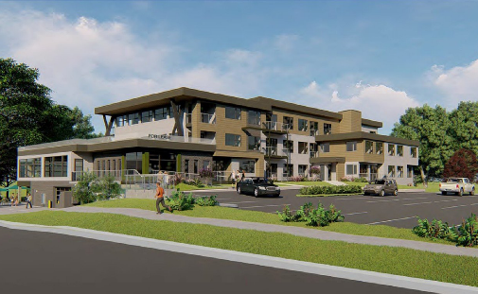
Projects - Various
Projects
Renovation / Replacement
New Construction / Adaptive Reuse
Waterloo
Technology Center
Office
PACE Financing: $249,000
PACE to Value: 12.5%
Annual Savings: $47,294
Lifetime Savings: $898,589
Improvements: HVAC and Lighting
The Edge at 706
Mixed-Use
PACE Financing: $1,420,000
PACE to Value: 9.0%
Annual Savings: $54,763
Improvements: LED Lighting, Shell Upgrades (Windows, Walls & Roof), Garage DCV
Uniroyal
Manufacturing
PACE Financing: $355,713
PACE to Value: 11%
Annual Savings: $70,698
Lifetime Savings: $989,777
Improvements: Roof Upgrades and Lighting
Weiskopf School Apartments
Multifamily
PACE Financing: $250,000
PACE to Value: 11%
Annual Savings: $2,134
Improvements: HVAC, LED Lighting, Roofing
H & H Energy
Industrial / Warehouse
PACE Financing: $203,875
PACE to Value: 8.0%
Annual Savings: $$9,910
Lifetime Savings: $208,110
Improvements: Roof Upgrades, Solar PV, Rooftop Heating and Cooling Units
Velocity
Multifamily
PACE Financing: $232,996
PACE to Value: 4.5%
Annual Savings: $5,206
Lifetime Savings: $104,123
Improvements: HVAC System, Windows, Lighting

Slide 10
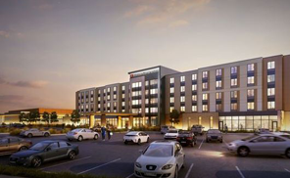
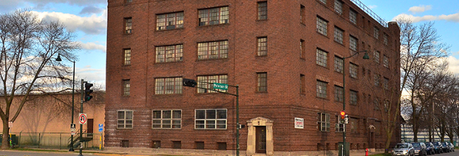
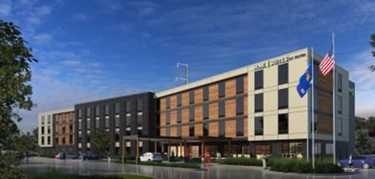
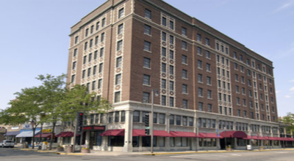
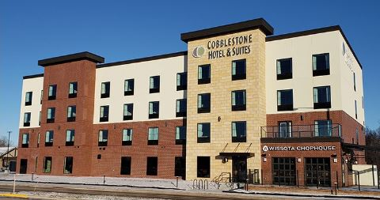
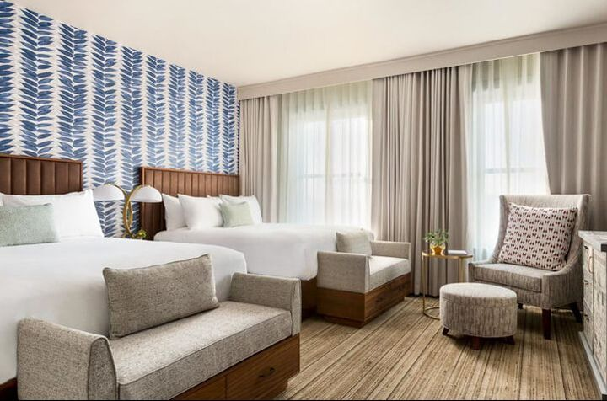
Projects - Hotels
Projects
New Construction
Renovation / Adaptive Reuse
Brookfield Square Lodging Investors, LLC
PACE Financing: $1,600,000
PACE to Value: 7.3%
Annual Savings: $94,168
Lifetime Savings: $2.1 Million Improvements: LED Lighting, HVAC, Roof and Wall Insulation, Windows, Low-flow Fixtures, Air Conditioner, Hot Water
Hotel Indigo
PACE Financing: $1,500,000
PACE to Value: 4.4%
Annual Savings: $89,832
Lifetime Savings: $1.9 million
Improvements: HVAC, Windows,
Building Shell, Lighting
Madison Rimrock
Lodging Investors, LLC
PACE Financing: $1,500,000
PACE to Value: 8.3%
Annual Savings: $90,840
Lifetime Savings: $1.82 Million
Improvements: Lighting, HVAC, Roof and Wall Insulation, Windows, Low-flow Fixtures, Air Conditioner, Hot Water
Hotel Retlaw
PACE Financing: $2,373,798
PACE to Value: 10.5%
Annual Savings: $289,011
Lifetime Savings: $6.3 Million
Improvements: HVAC, Lighting,
Windows, Roof
Fox Crossing Hotel Group, LLC
PACE Financing: $850,000
PACE to Value: 12.1%
Annual Savings: $41,008
Lifetime Savings: $780,000
Improvements: Lighting, HVAC, Roof and Wall Insulation, Windows, Low-flow Fixtures, Air Conditioner, Pool, DHW Efficiency
Hotel Northland
PACE Financing: $8,759,000
PACE to Value: 23.3%
Annual Savings: $454,000
Lifetime Savings: $13.2 Million
Improvements: Roof and wall insulation, LED lighting, heating ventilation and air conditional (HVAC) central plant, HVAC air handling and fan coiling units, low-flow showers and faucets, and exterior LEDs.

Slide 11

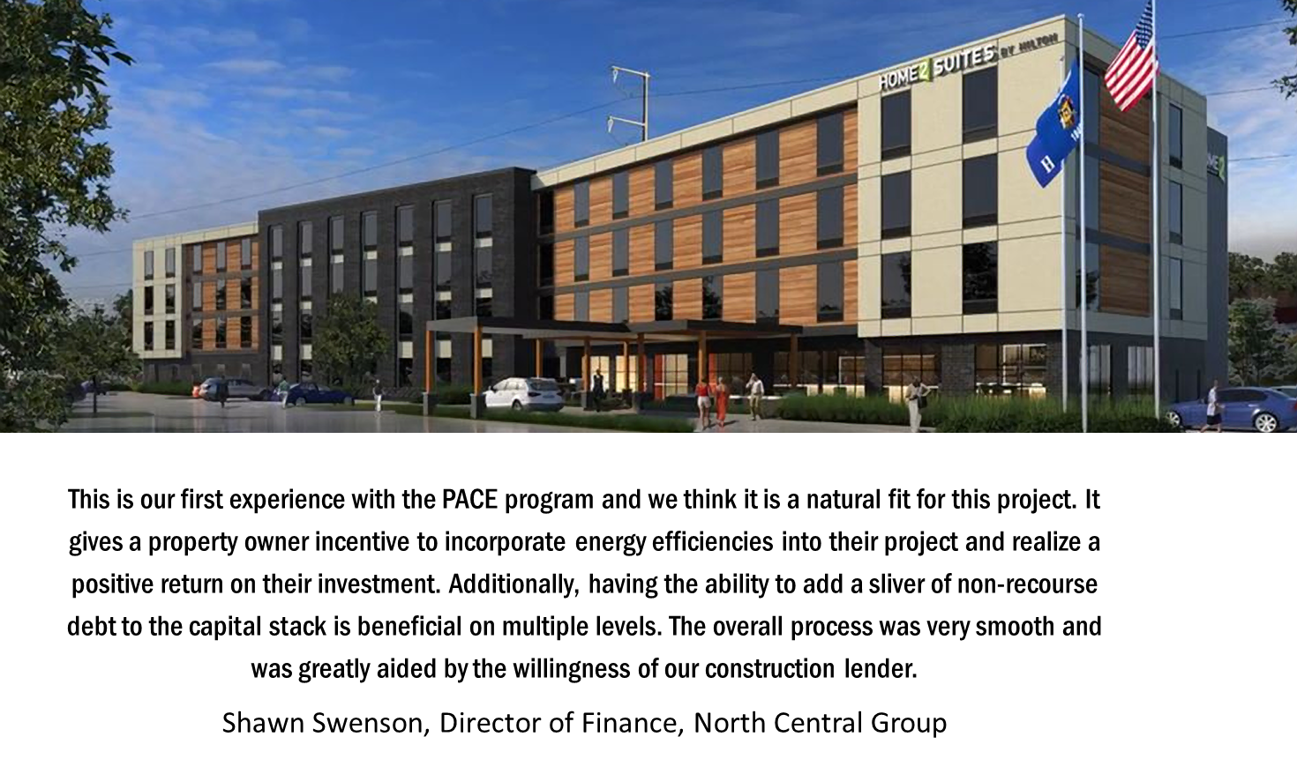

Slide 12
Typical C-PACE Financing Terms
Financing Terms (Set by the Market)
Loan Term: 5 – 30 years (Full Amortization)
Interest Rate: 300 – 450 bps over Index (~5.00% - 6. 50%)
Loan Size: $100,000 - $50.0 Million
PACE Loan-to-Value (LTV): 5%-35%
Statutory & PACE WI Program Requirements:
Mortgage Lender must consent to PACE Financing
Savings Guarantee: Projects > $250,000
Energy Assessment
Security: Property Tax Assessment
Term: Equal to Useful Life of Equipment
Total Secured LTV: 95%
Loan-to-Cost: Up to 100%
PACE

Slide 13


















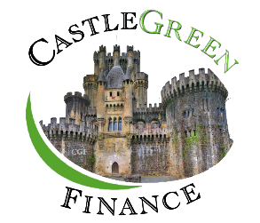


Capital Providers – Open Market
Contact information:
www.pacewi.org/participating-pace-lenders.html

Slide 14


Key Milestones for Success
Active PACE Program
Property Owner Engagement
PACE Capital Provider Commitment
Mortgage Lender Consent
Qualify Clean Energy Project

Slide 15

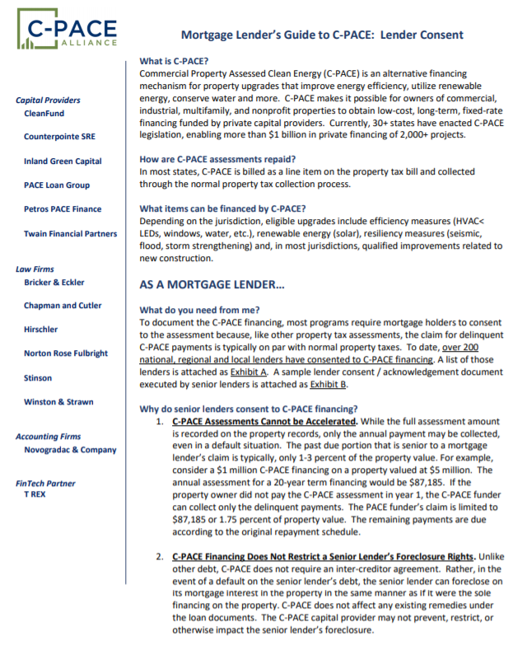
Mortgage Lender Consent
Why do Mortgage Lenders Consent?
Maintain valuable relationships.
PACE Projects improve the lender’s collateral.
The projects also improve cash flow, which boosts DS coverage
Upon a default PACE financings don’t accelerate. Lender is only ever subordinated to delinquent payments.
C-PACE Alliance Resources:
www.c-pacealliance.com/what-we-do/publications/

Slide 16
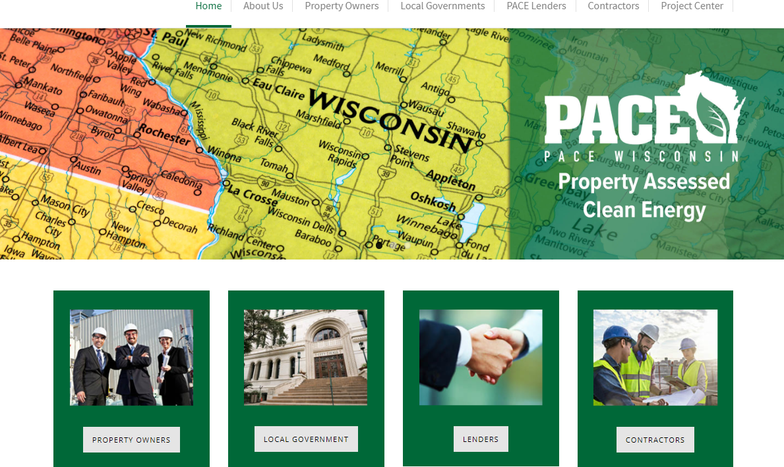
PACE Wisconsin – www.pacewi.org
www.pacewi.org

